Slide 1
Football Management System
BY: Aditya Kamat (1BM18IS003)
Aryan (1BM18IS018)

Slide 2
CONTENTS
01
Introduction
02
Schema Diagram
03
Tables
04
ER Diagram
05
Result

Slide 3
Introduction
This Project is based on a football management system, where users can access information about the players, various football clubs, football managers, team information etc. from the database.
Users can create an account to experience the various features of the software. There are two types of accounts in the system, namely the regular accounts and the premi-um accounts.
Regular accounts can access only details about the players and nothing else. The regular account users can enter their preferred player name they want to search for.
The details of the corresponding player will be retrieved from the ‘all players’ table and displayed. This is the only feature that the regular account holders can experience.
The premium account holders have access to a wide range of details, statistics and information about the clubs, players and managers.
For premium users, there is an option in the home screen navigation bar called premium, where they will be asked to enter their account credentials.

Slide 4
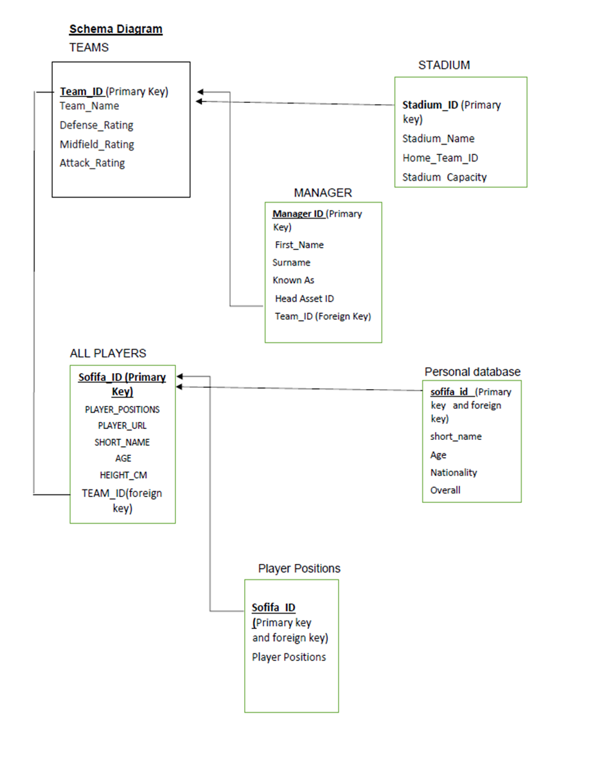
Schema Diagram

Slide 5
Tables
1)The All players – This table consists of the data of all the players from various clubs, with attributes/columns such as height, name etc
2) The Login_track – This table is used for keeping a track of the users who have logged in. It also helps in storing the details of the users’ login time for their current session as well as the previous session.
3) The Manager – This table consists of information on the managers belonging to various football clubs.
4) The Personal Details –User can edit only those aspects that were mentioned in the table except for the primary key. The changes will be reflected in this table as well as all players table.
5) The Premium_logs – This table records if the user has been updated to premium using triggers.
6) The Stadiums –This table contains information on various stadiums.
7) The Update_logs – This table’s records get updated whenever admin updates user data.
8) The Users – This table contains data of all the users.
9) The Teams – The teams table contains information about the teams.

Slide 6
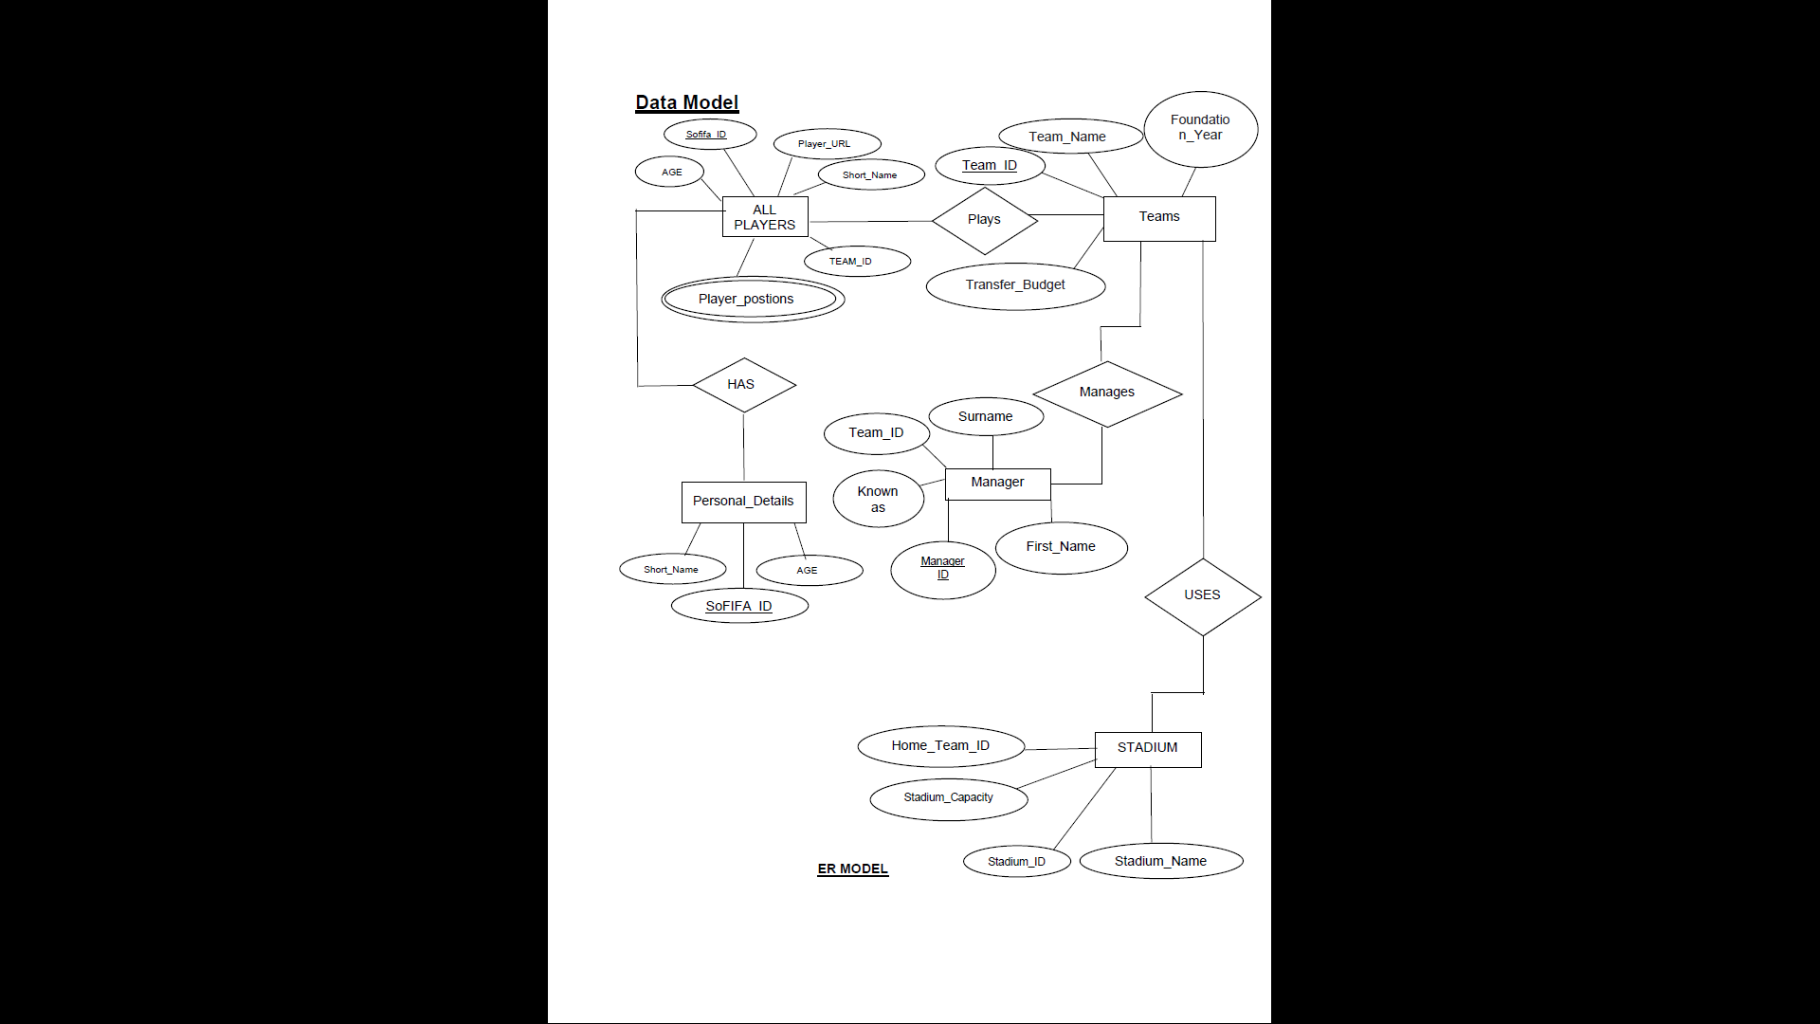
ER Diagram

Slide 7
Result
The football management system that has been developed in this project allows users to access information related to football players, clubs and other aspects related to the game.
The system acts as a one-point destination for users eager to know about the various details and statistics of the game. It allows users to create accounts and rewards them with points based on their activity in the system and upgrades them to premium if their activity matches certain criteria.
As a premium account holder, the user gets exposed to profound information about various clubs, managers and the skill set of the players.
One of the limitations is that we cannot delete player data.
Another limitation the admin cannot manage the users. The future enhancements can have the features of football news, fixtures and the up-gradation to the premium account can be based on a subscription basis.

Slide 8
THANK YOU

